Slide 1
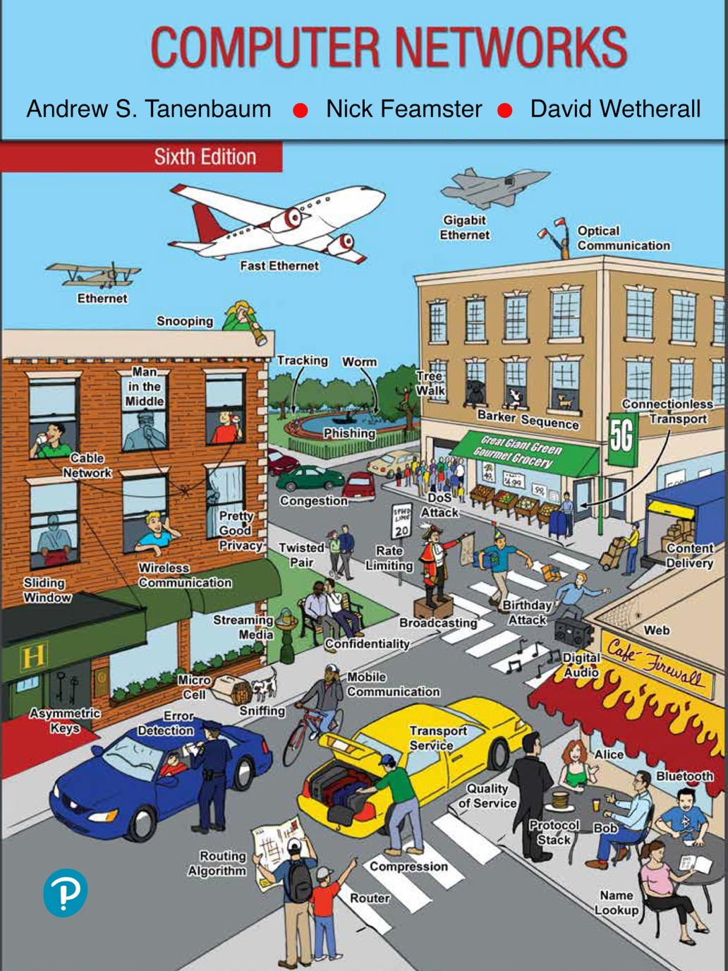
Chapter 7
The Application Layer

Slide 2
The Domain Name System (DNS)
History and overview
The DNS lookup process
The DNS name space and hierarchy
DNS queries and responses
Name resolution
Hands on with DNS
DNS privacy
Contention over names
An organization’s Web server could be referred to as www.cs.uchicago.edu, regardless of its IP address. Because the devices along a network path forward traffic to its destination based on IP address, these human-readable domain names must be converted to IP addresses; the DNS (Domain Name System) is the mechanism that does so.

Slide 3
History and Overview
ARPANET days
hosts.txt listed all computer names and their IP addresses
Hosts fetched the file nightly
Worked reasonably well for the time
The Internet grew
The hosts.txt file grew to be large
Needed central management to prevent host name conflicts
Domain Name System invented in 1983
Hierarchical naming scheme
Distributed database system implements the naming scheme
Maps host names to IP addresses

Slide 4
The DNS Lookup Process
Stub resolver process to map a name onto an IP address
Stub resolver sends a query containing the name to a local DNS resolver
Local DNS resolver performs a recursive lookup for the name against a set of DNS resolvers
Local recursive resolver ultimately returns the corresponding IP address to the stub resolver
Stub resolver passes the result to the function that issued the query in the first place
Query and response messages are sent as UDP packets
Program can use the IP address to communicate with the host corresponding to the DNS name that it had looked up

Slide 5
The DNS Lookup Process
All of the answers, including all the partial answers returned, are cached. In this way, if a computer at cs.vu.nl queries for cs.uchicago.edu, the answer is cached.
If shortly thereafter, another host at cs.vu.nl also queries cs.uchicago.edu, the answer will already be known.
Even better, if a host queries for a different host in the same domain, say noise.cs.uchicago.edu, the query can be sent directly to the authoritative name server for cs.uchicago.edu.
Similarly, queries for other domains in uchicago.edu can start directly from the uchicago.edu name server.

Slide 6
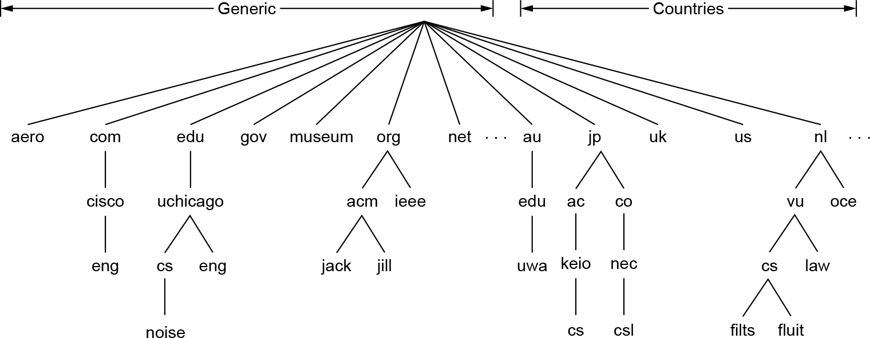
The DNS Name Space and Hierarchy
The leaves of the tree represent domains that have no subdomains (but do contain machines, of course). A leaf domain may contain a single host, or it may represent a company and contain thousands of hosts.
The top-level domains have several different types: gTLD (generic Top Level Domain), ccTLD (country code Top Level Doman), and others.
A portion of the Internet domain name space

Slide 7
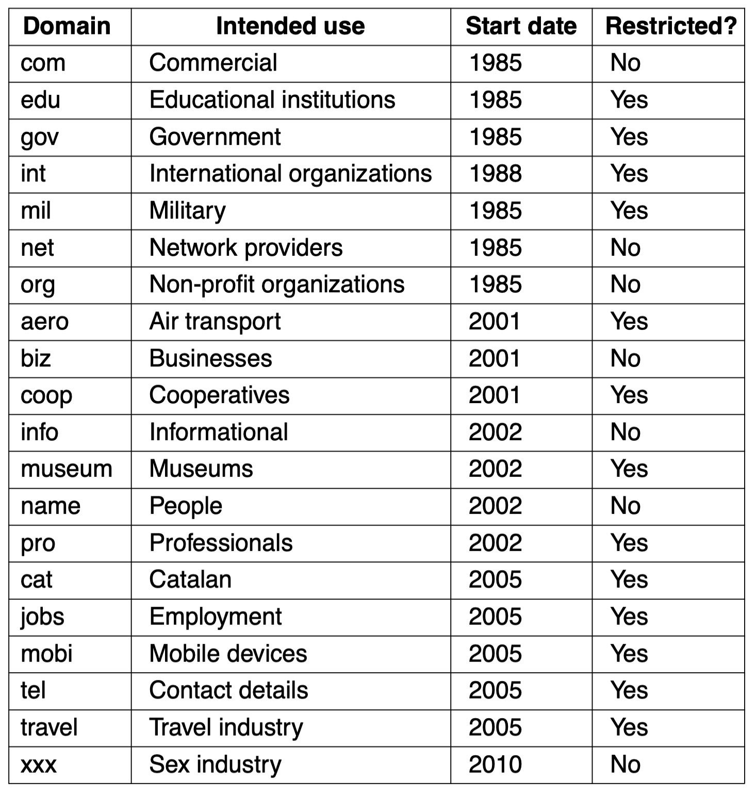
The DNS Name Space and Hierarchy
The original generic TLDs, as of 2010. As of 2020, there are more than 1,200 gTLDs.

Slide 8
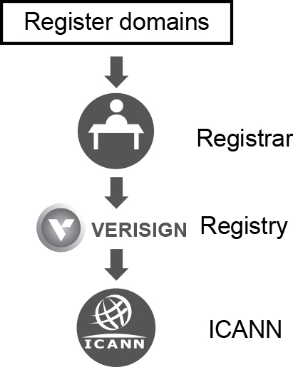
The DNS Name Space and Hierarchy
Getting a second-level domain, such as name-of-company.com, is easy.
The top-level domains are operated by companies called registries. They are appointed by ICANN. For example, the registry for com is Verisign.
One level down, registrars sell domain names directly to users. There are many of them and they compete on price and service. Common registrars include Domain.com, GoDaddy, and NameCheap.
The relationship between registries and registrars

Slide 9
DNS Queries and Responses
DNS queries
Extensions and enhancements to DNS queries
DNS responses and resource records
Common record types
DNSSEC records
DNS zones

Slide 10
DNS Resource Record
Every domain, whether it is a single host or a top-level domain, can have a set of resource records associated with it. These records are the DNS database.
A resource record is a five-tuple
Domain_name Time_to_live Class Type Value
The Domain_name tells the domain to which this record applies.
The Time_to_live field gives an indication of how stable the record is.
The third field of every resource record is the Class. For Internet information, it is always IN. For non-Internet information, other codes can be used, but in practice these are rarely seen.
The Type field tells what kind of record this is.

Slide 11
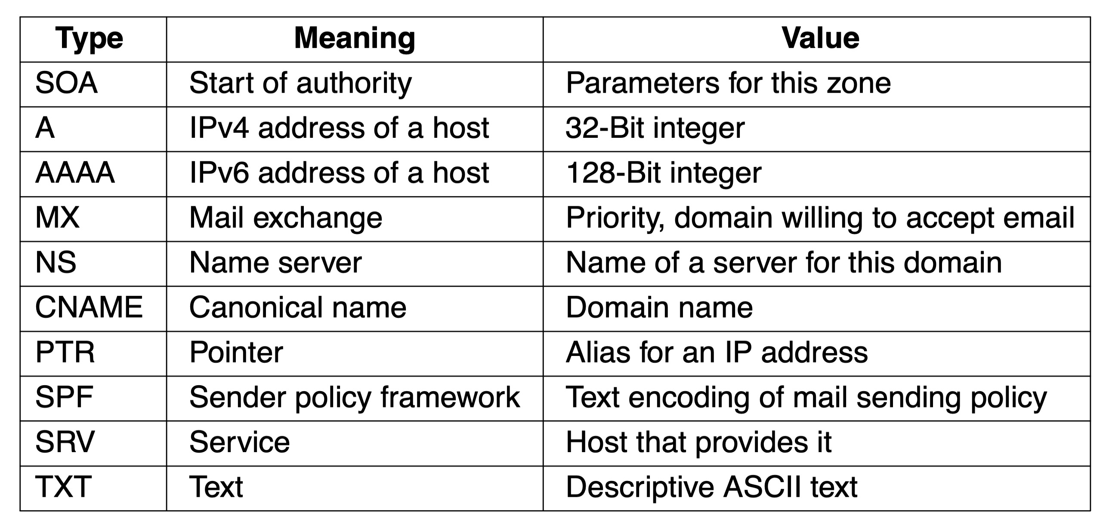
DNS Resource Record Types

Slide 12
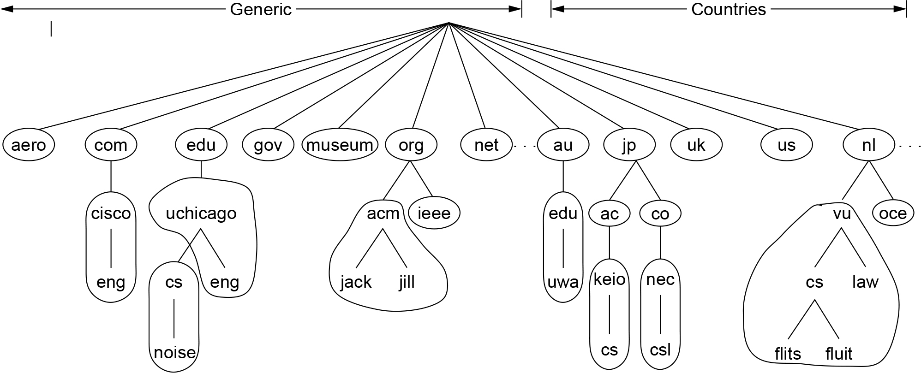
DNS Zones
In theory at least, a single name server could contain the entire DNS database and respond to all queries about it. In practice, this server would be so overloaded as to be useless. Furthermore, if it ever went down, the entire Internet would be crippled.
To avoid the problems associated with having only a single source of information, the DNS name space is divided into nonoverlapping zones.
Part of the DNS name space divided into zones (which are circled)

Slide 13
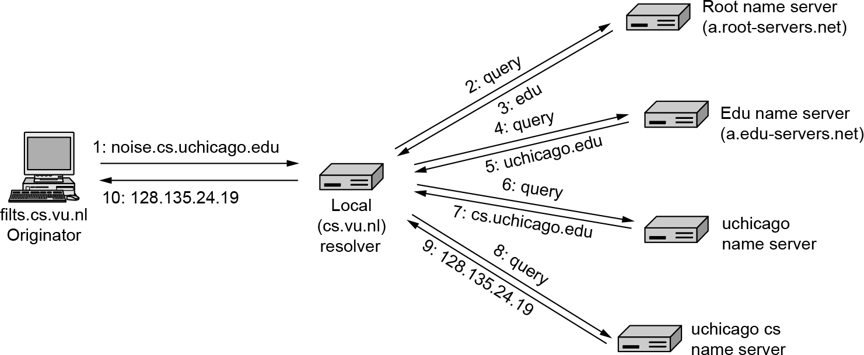
Name Resolution
The process of looking up a name and finding an address is called name resolution. If there is no cached information about the domain available locally, the name server begins a remote query.
Example of a resolver looking up a remote name in 10 steps

Slide 14
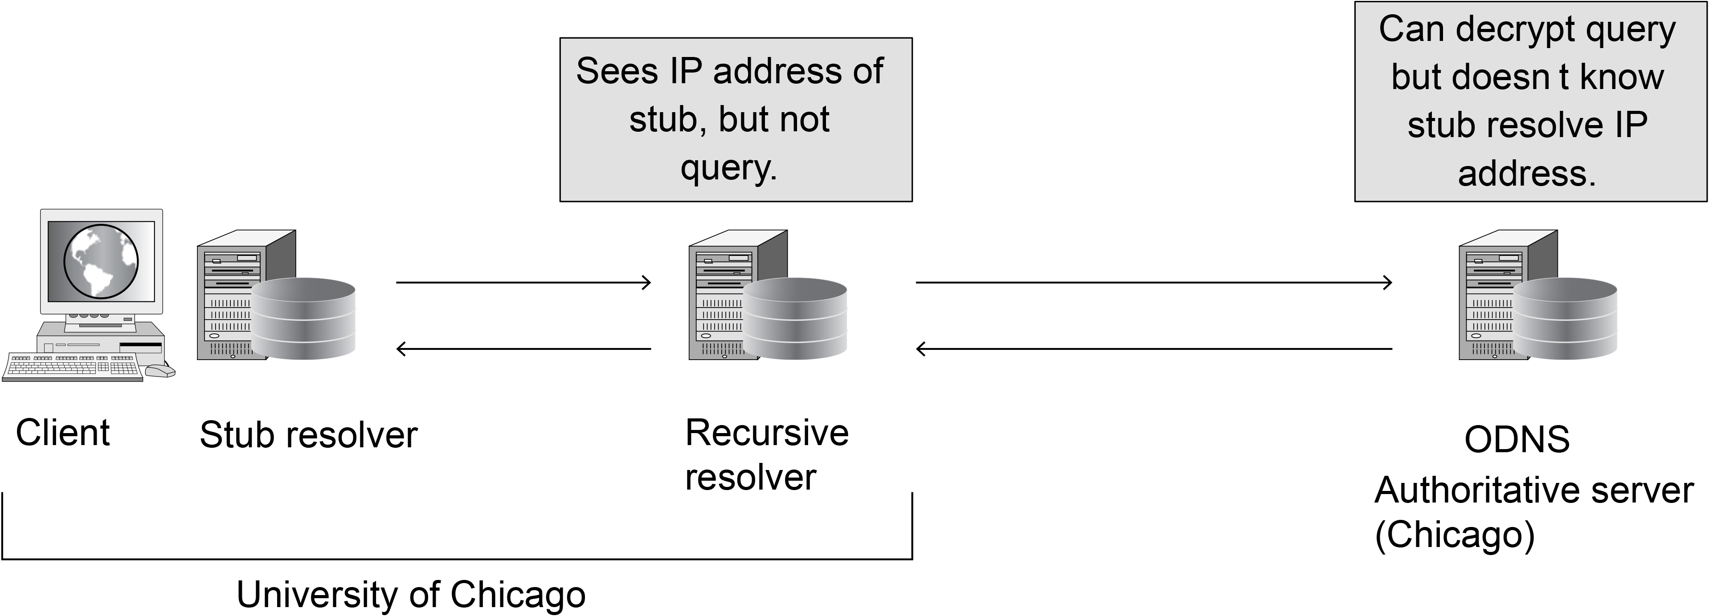
DNS Privacy
The stub resolver encrypts the original query to the local recursive resolver, which in turn sends the encrypted query to an authoritative name serve that can decrypt and resolve the query, but does not know the identity or IP address of the stub resolver that initiated the query.
Oblivious DNS

Slide 15
Electronic Mail
Architecture and services
The user agent
Message formats
Message transfer
Final delivery

Slide 16
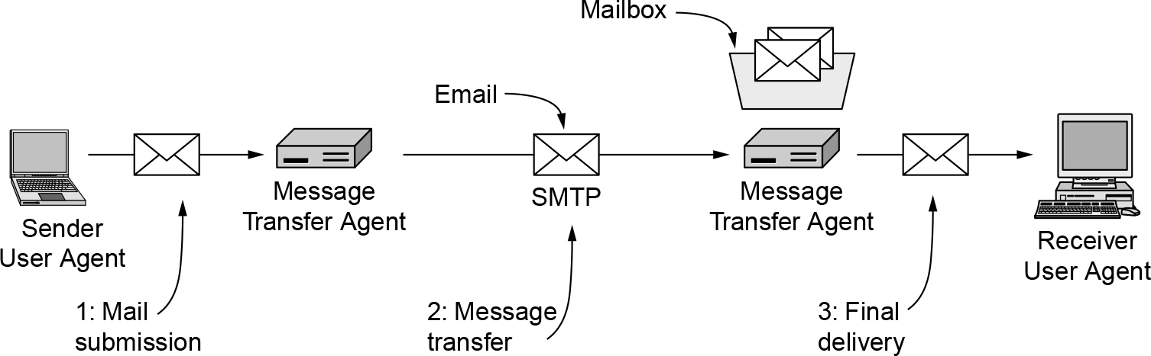
Architecture and Services
The user agent is a program that provides a graphical interface, or sometimes a textand command-based interface that lets users interact with the email system. The act of sending new messages into the mail system is called mail submission (step 1).
The message transfer agents are typically system processes. They run in the background on mail server machines and are intended to be always available. Their job is to automatically move email through the system from the originator to the recipient with SMTP (Simple Mail Transfer Protocol). This is the message transfer step (step 2).
Linking user and message transfer agents are the concepts of mailboxes and a standard format for email messages. Mailboxes store the email that is received for a user.
The retrieval of mail is the final delivery (step 3).
Architecture of the email system

Slide 17
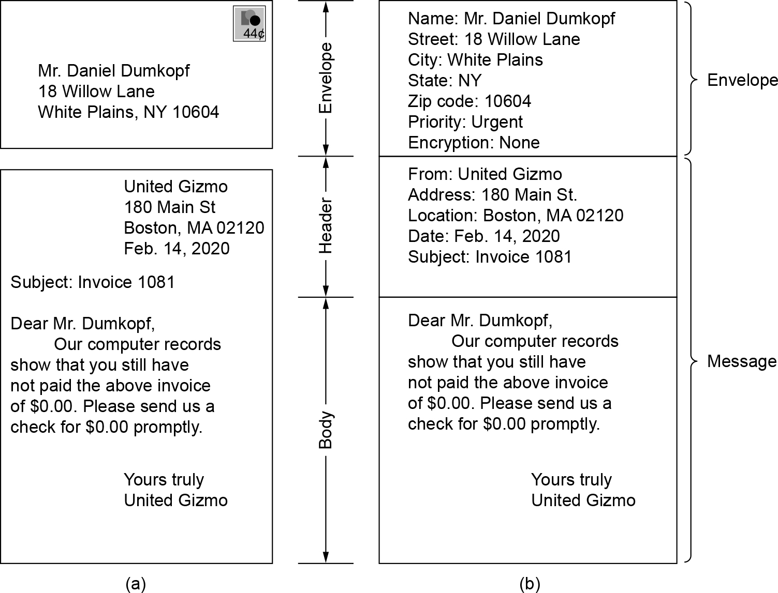
Architecture and Services
The message inside the envelope consists of two separate parts: the header and the body. The header contains control information for the user agents. The body is entirely for the human recipient.
Envelopes and messages. (a) Paper mail. (b) Electronic mail.

Slide 18
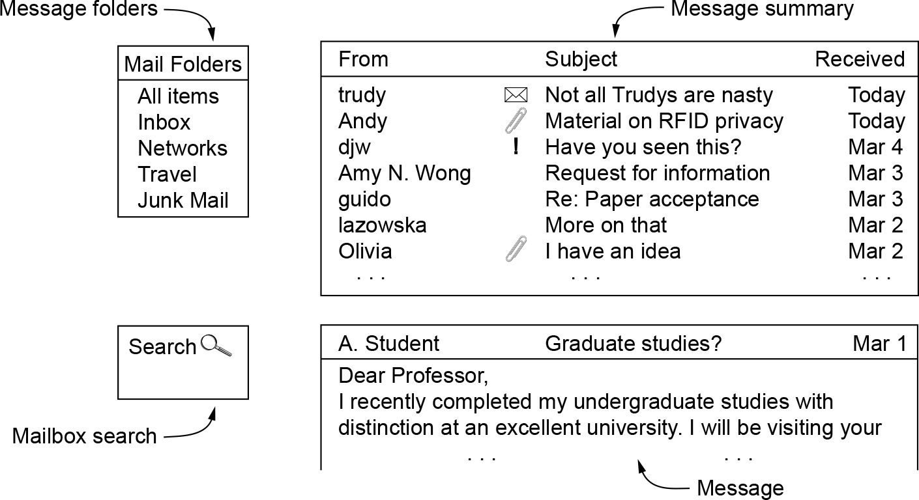
The User Agent
There are many popular user agents, including Google Gmail, Microsoft Outlook, Mozilla Thunderbird, and Apple Mail. When a user agent is started, it will usually present a summary of the messages in the user’s mailbox. Often, the summary will have one line for each message in some sorted order. It highlights key fields of the message that are extracted from the message envelope or header.
Typical elements of the user agent interface.

Slide 19
Message Formats
RFC 5322—the Internet message format
Basic ASCII email using RFC 5322
Latest revision of the original Internet message format
MIME—the Multipurpose Internet Mail Extensions
Multimedia extensions to the basic format

Slide 20
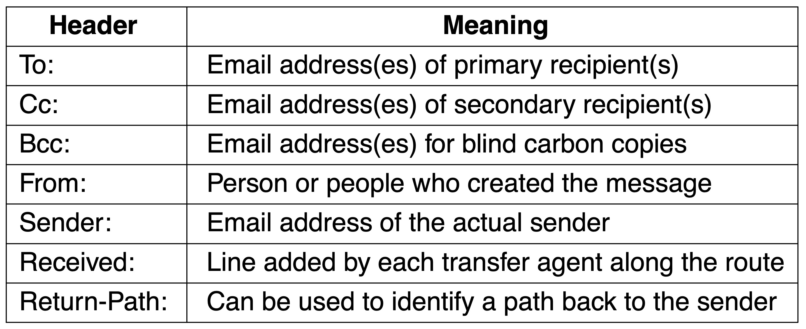
Message Formats
RFC 5322 header fields related to message transport

Slide 21
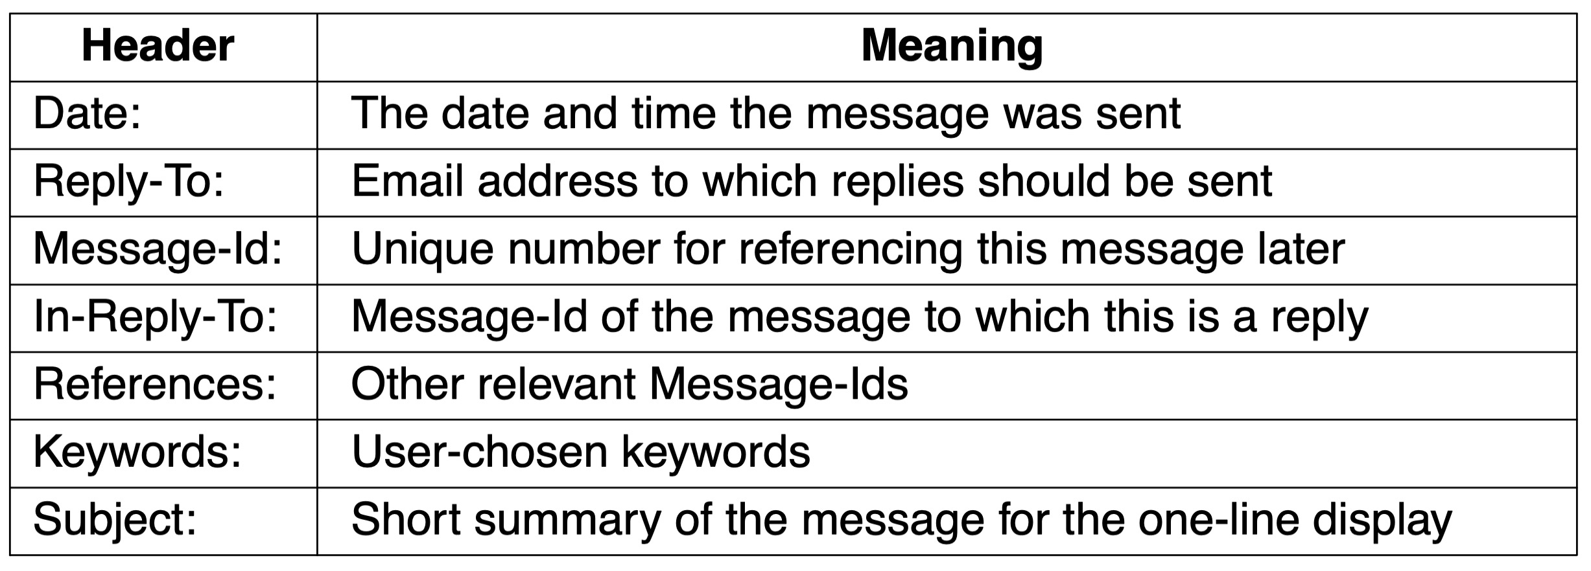
Message Formats
Some fields used in the RFC 5322 message header

Slide 22
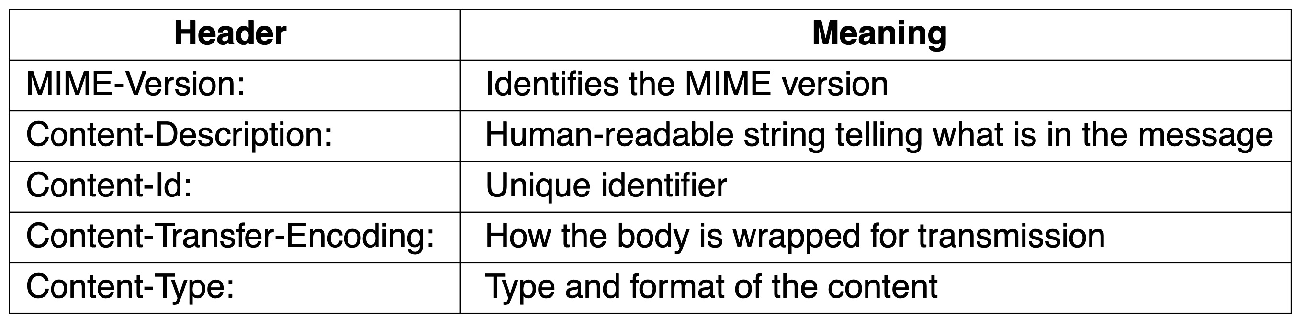
Message Formats
Message headers added by MIME

Slide 23
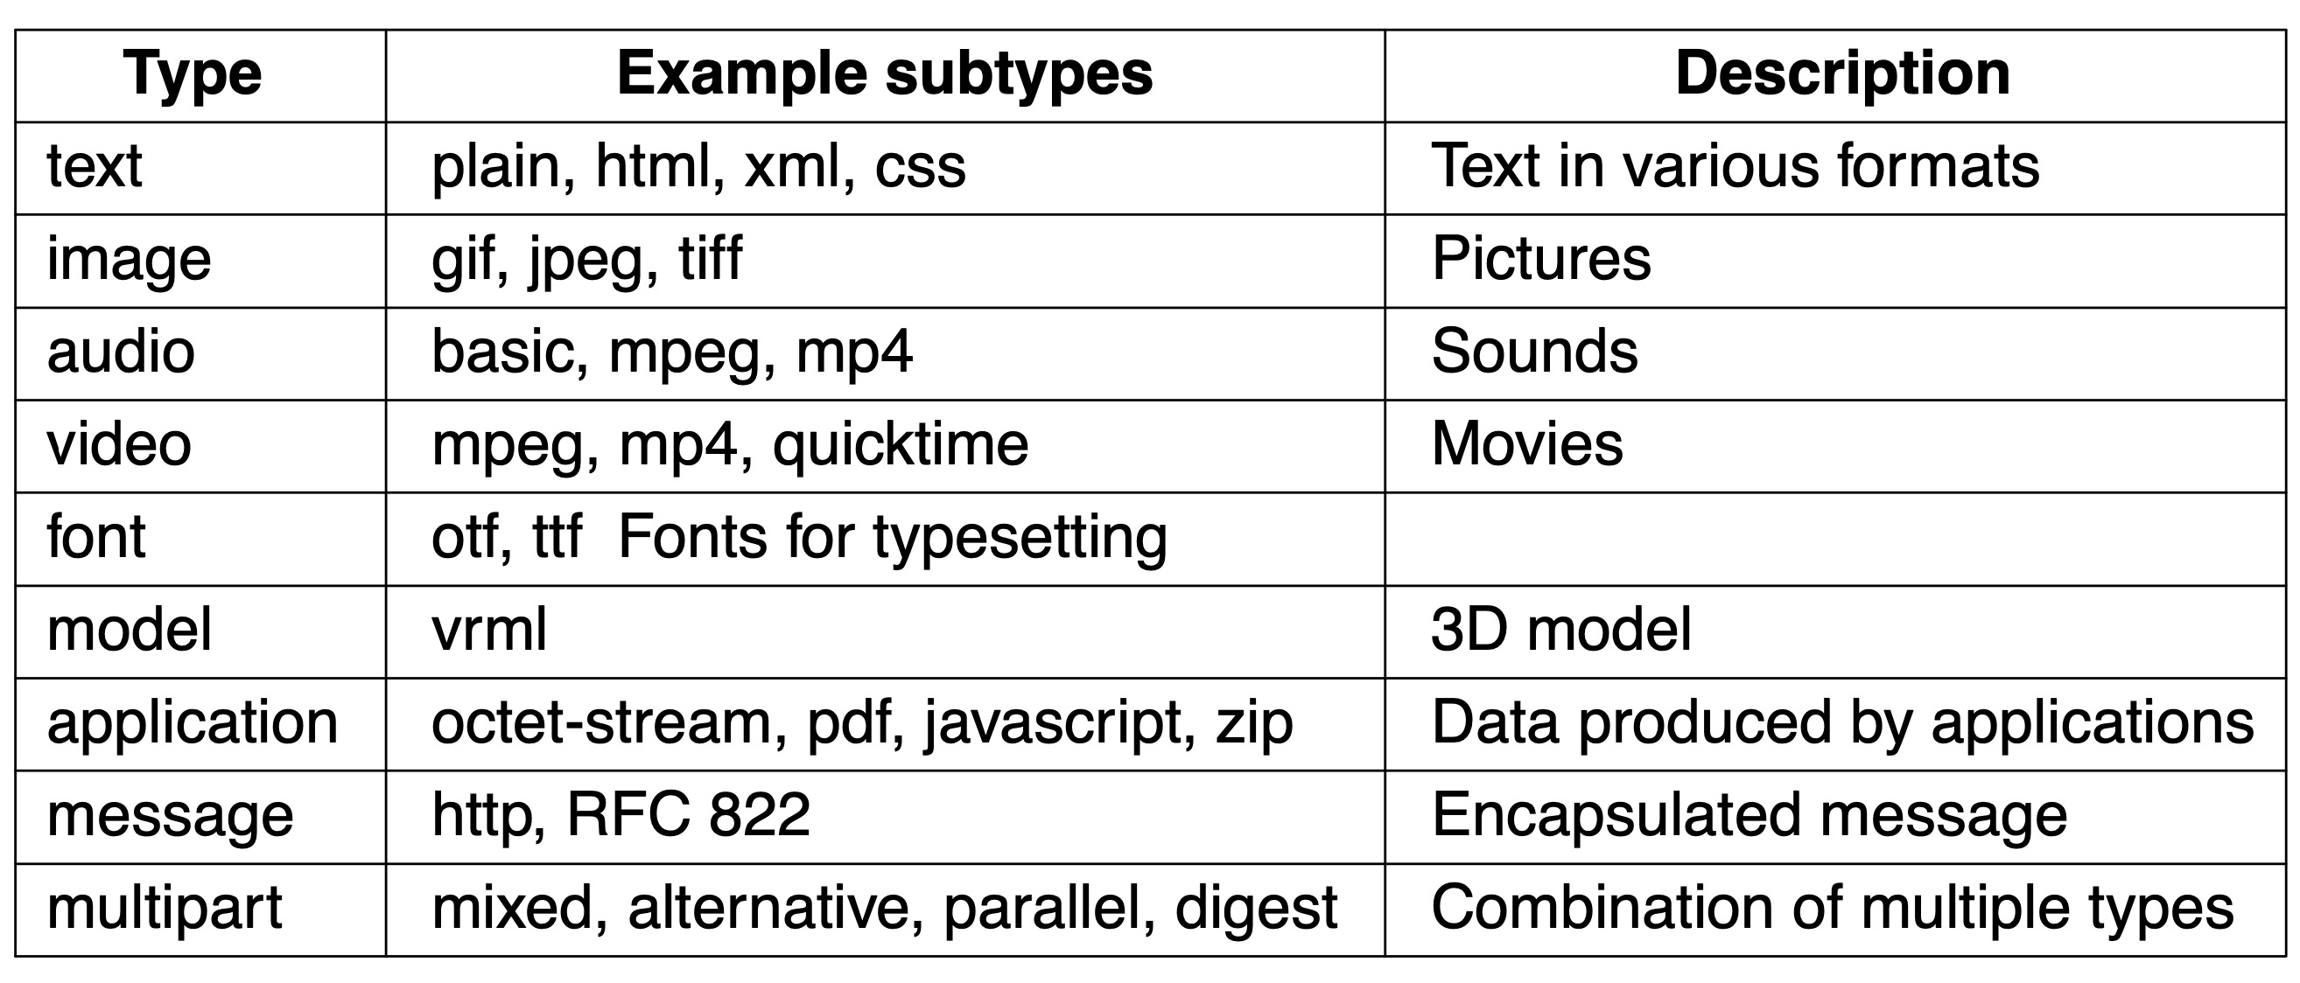
Message Formats
MIME content types and example subtypes

Slide 24
Message Transfer
SMTP (Simple Mail Transfer Protocol) and extensions
Mail submission
Physical transfer

Slide 25
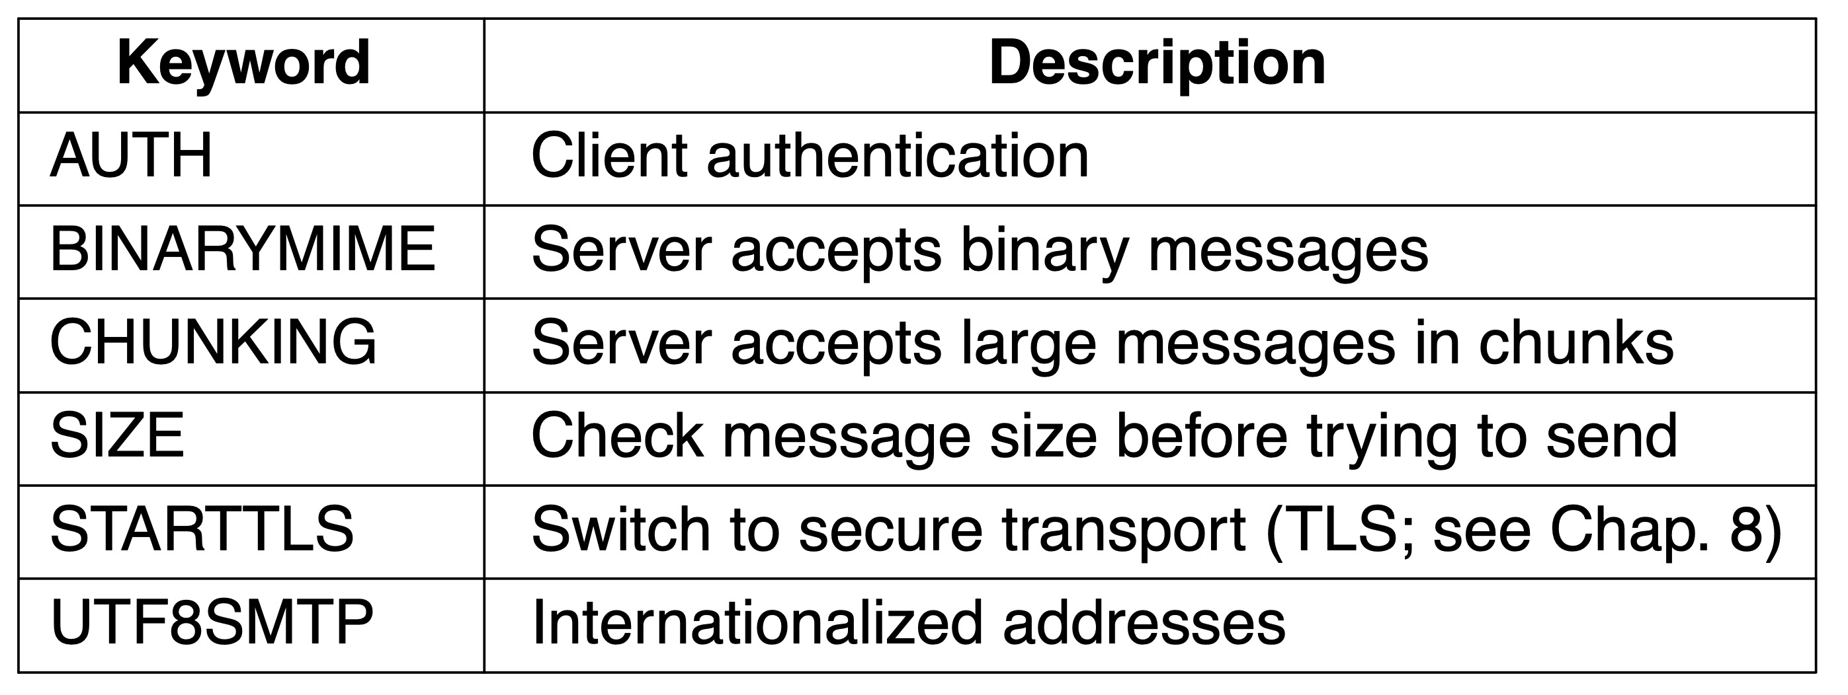
Message Transfer
Some SMTP extensions

Slide 26
Final Delivery
IMAP—the Internet Message Access Protocol
Main protocol used for final delivery
Improvement over POP3 (Post Office Protocol, version 3)
The mail server runs an IMAP server that listens to port 143
The user agent runs an IMAP client
The client connects to the server and begins to issue commands
Webmail
Alternative to IMAP and SMTP for providing email service
Uses the Web as an interface

Slide 27
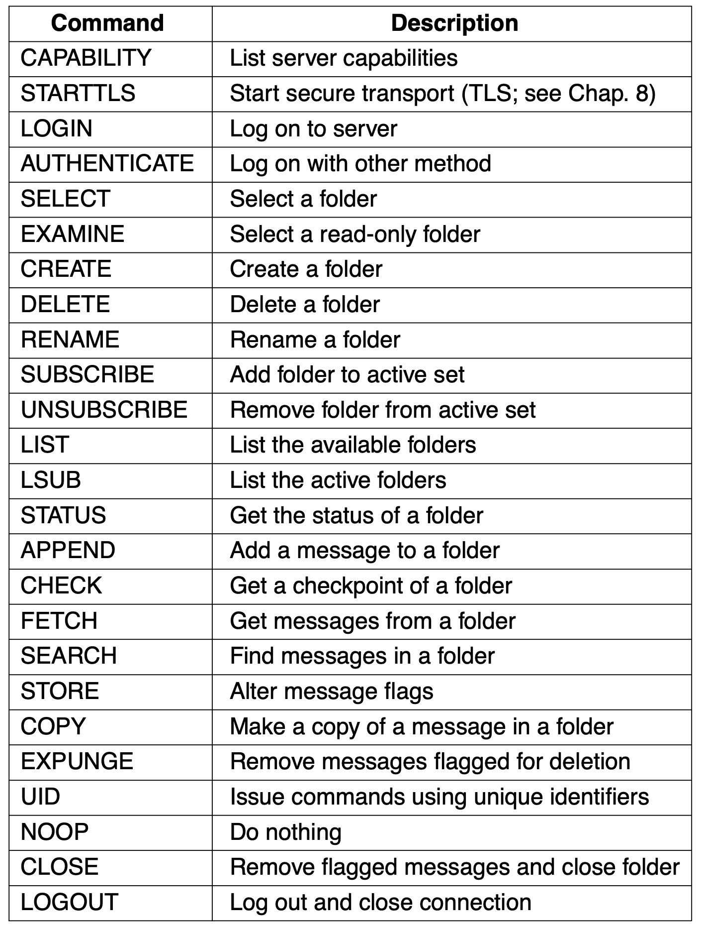
Final Delivery
IMAP (version 4) commands

Slide 28
The World Wide Web
Architectural overview
Static Web objects
Dynamic Web pages and Web applications
HTTP and HTTPS
Web privacy

Slide 29
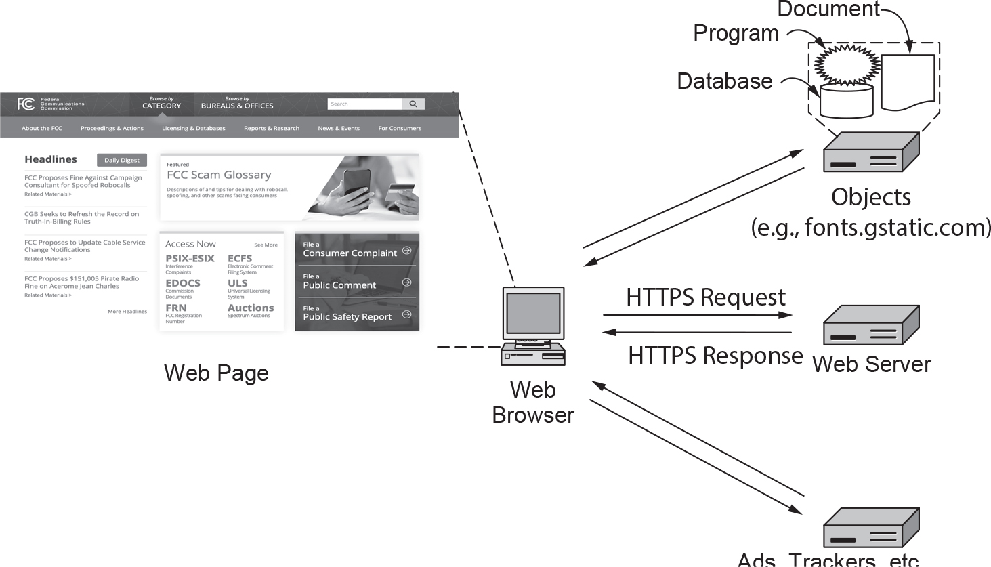
Architectural Overview (1 of 8)
Fetching and rendering a Web page involves HTTP/HTTPS requests to many servers

Slide 30
Architectural Overview (2 of 8)
The client side
Three questions had to be answered before a selected page was displayed:
What is the page called?
Where is the page located?
How can the page be accessed?

Slide 31
Architectural Overview (3 of 8)
Steps that occur when a link is selected:
Browser determines the URL
Browser asks DNS for the IP address of the server
DNS replies
Browser makes a TCP connection
Sends HTTP request for the page
Server sends the page as HTTP response
Browser fetches other URLs as needed
Browser displays the page
The TCP connections are released

Slide 32
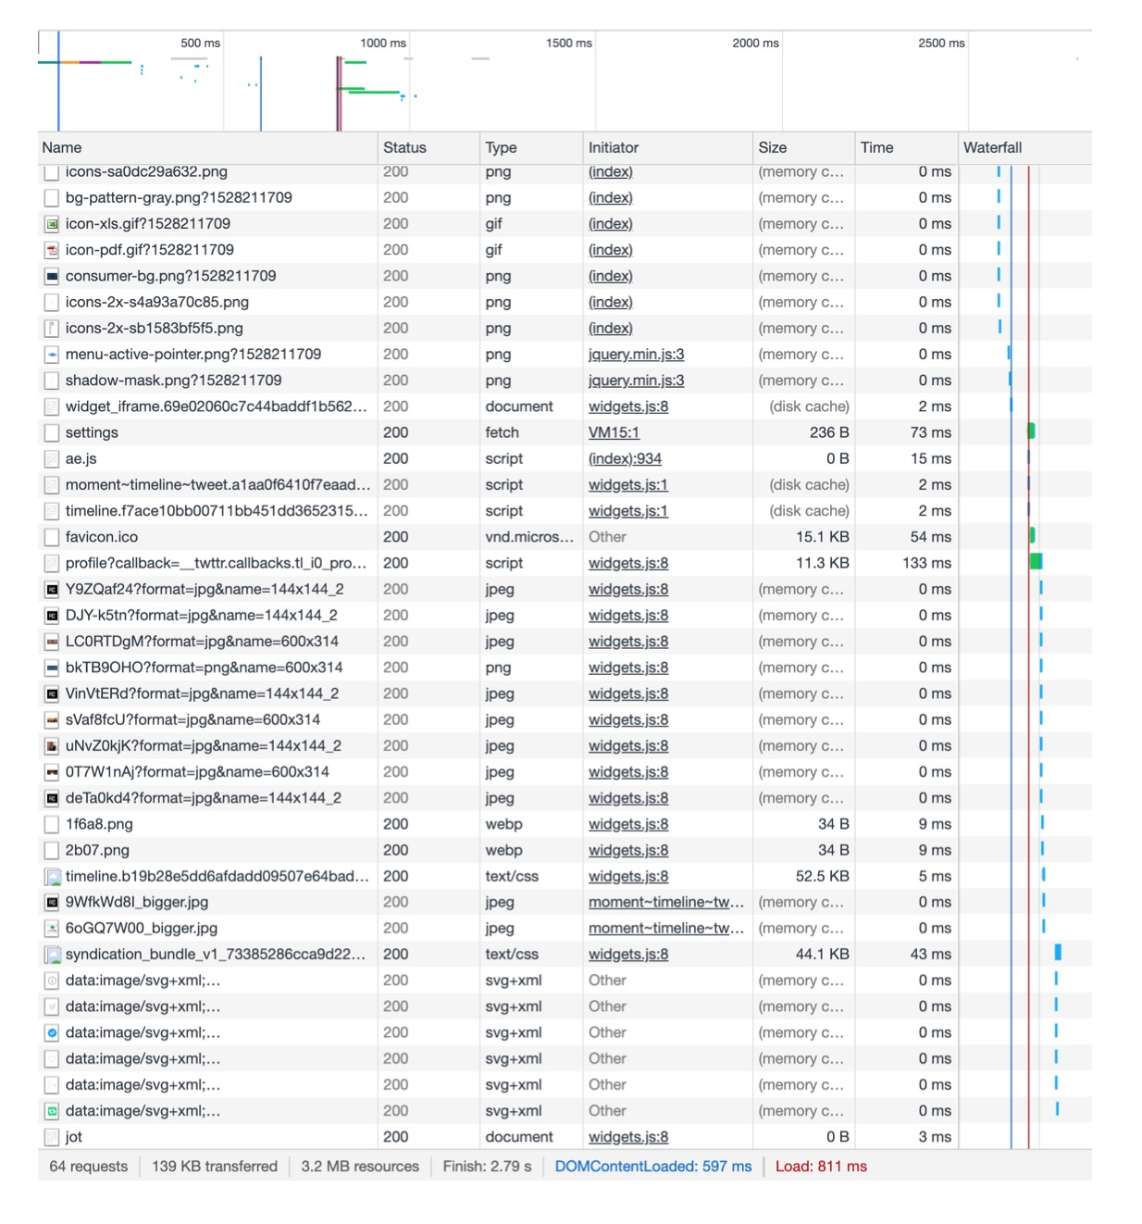
Architectural Overview (4 of 8)
Waterfall diagram for fcc.gov

Slide 33
Architectural Overview (6 of 8)
Steps the server performs in its main loop:
Accept a TCP connection from a client (a browser)
Get the path to the page, which is the name of the file requested
Get the file (from disk)
Send the contents of the file to the client
Release the TCP connection
Modern Web servers have more features
For dynamic content
Third step may be replaced by the execution of a program that generates and returns the contents

Slide 34
Architectural Overview (7 of 8)
Server design problem: slow disk access bottleneck
Solution: maintain a cache in memory
Server design problem: one request processed at a time
Solution: make the server multithreaded
Modern Web architectures use a split between a front end and a back end
Front-end Web server (reverse proxy)
Retrieves content from other (typically back-end) servers
Serves those objects to the client
Acts on behalf of the servers – not on the behalf of clients

Slide 35
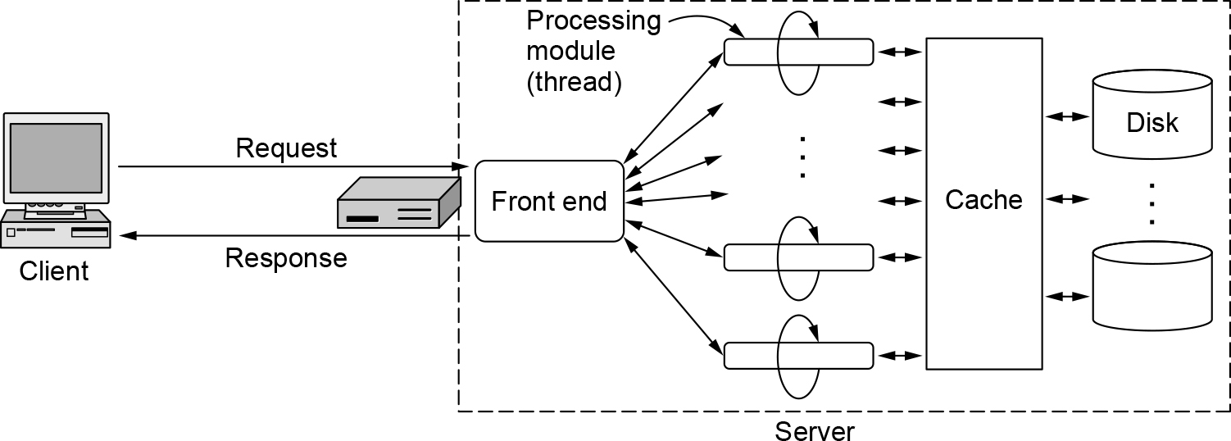
Architectural Overview (8 of 8)
A multithreaded Web server with a front end and processing modules

Slide 36
Static Web Objects
Static objects
Files sitting on a server, presenting themselves in the same way each time they are fetched and viewed
Examples: logo, style sheets, header and footer
Generally amenable to caching
Most Web pages have dynamic content
Significant amount of the content remains static
Web page design
Use HTML or CSS (Cascading Style Sheets)
Use programs (Adobe Dreamweaver)

Slide 37
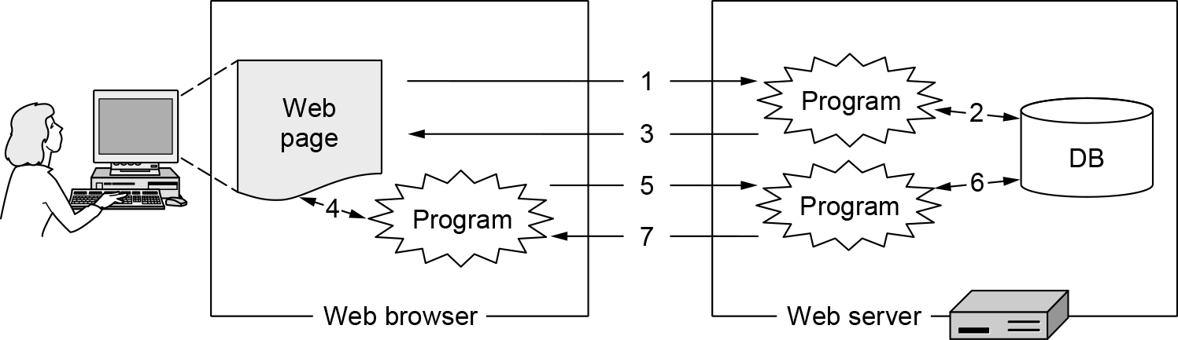
Dynamic Web Pages and Web Applications (1 of 2)
Dynamic pages

Slide 38
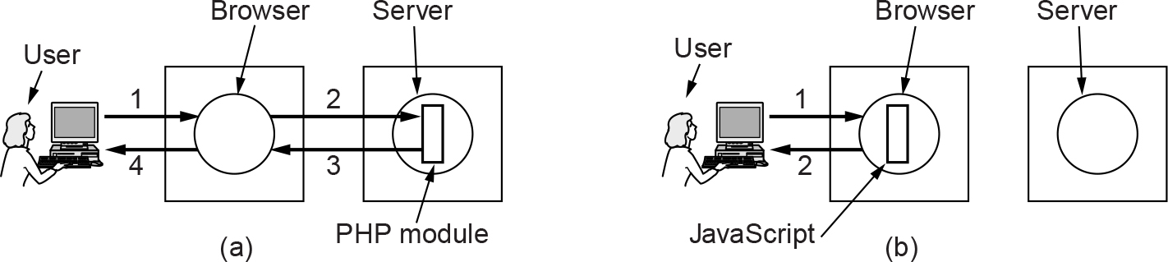
Dynamic Web Pages and Web Applications (2 of 2)
(a) Server-side scripting with PHP. (b) Client-side scripting with JavaScript.

Slide 39
HTTP and HTTPS (1 of 7)
Overview
Methods
Message headers
Caching
HTTP/1 and HTTP/1.1
HTTP/2
HTTP/3

Slide 40
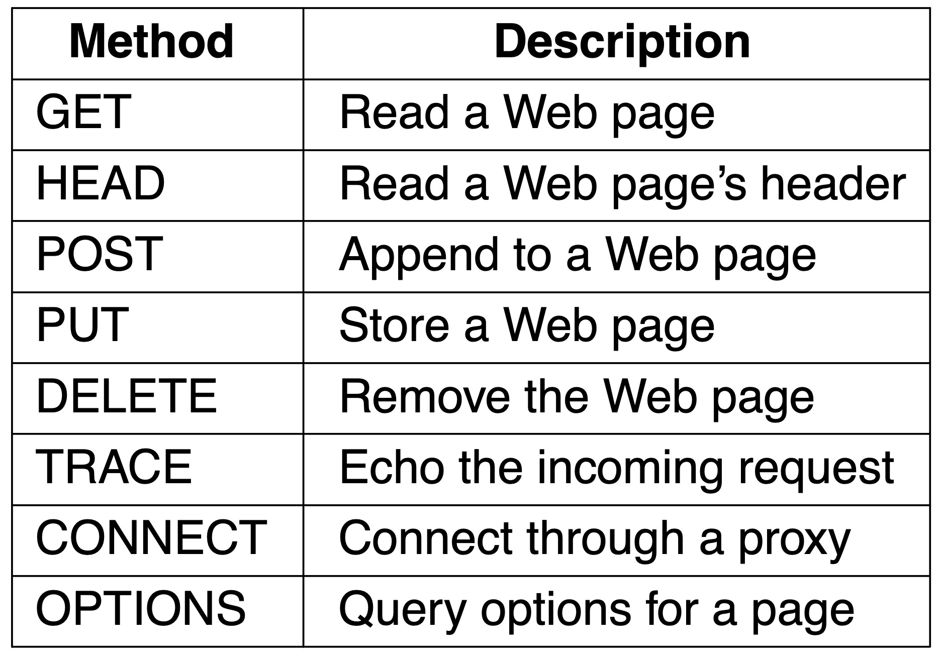
HTTP and HTTPS (2 of 7)
The built-in HTTP request methods

Slide 41
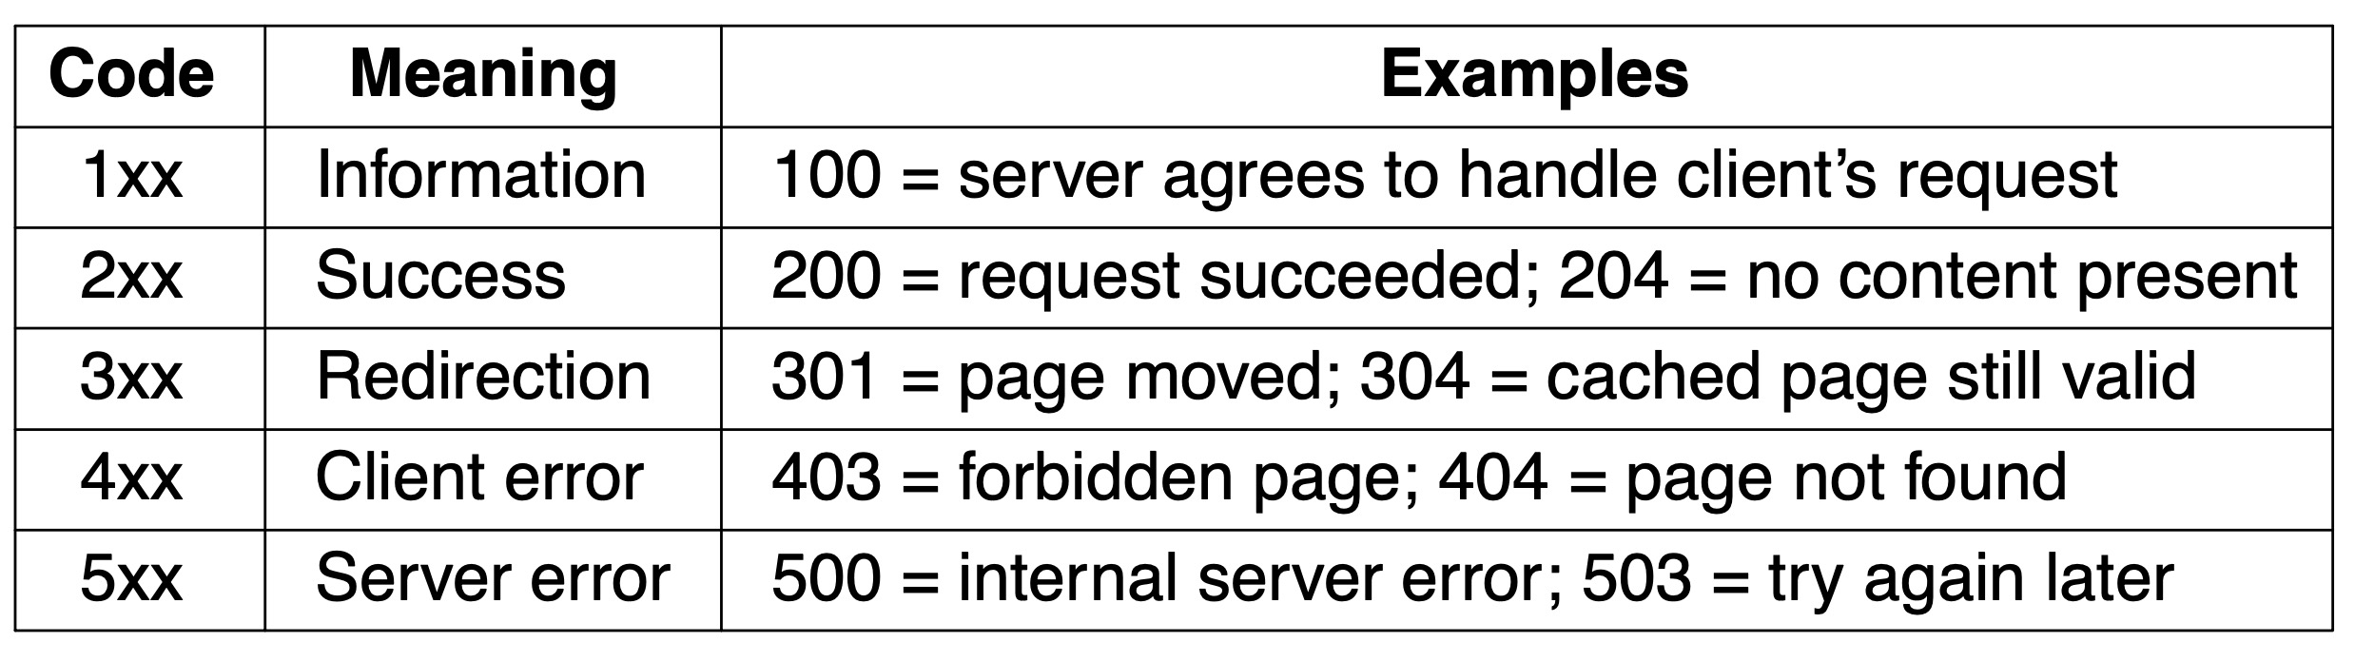
HTTP and HTTPS (3 of 7)
The status code response groups

Slide 42
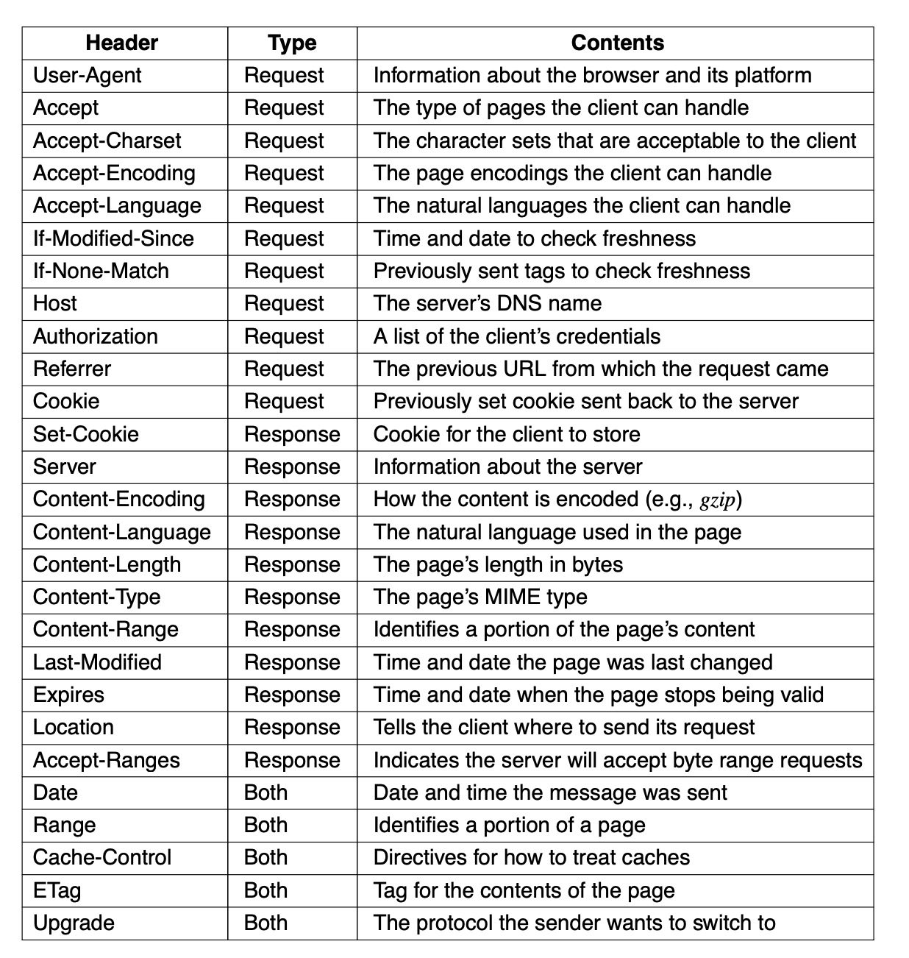
HTTP and HTTPS (4 of 7)
Some HTTP message headers

Slide 43
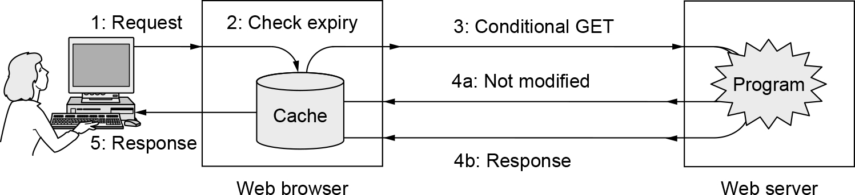
HTTP and HTTPS (5 of 7)
HTTP caching

Slide 44
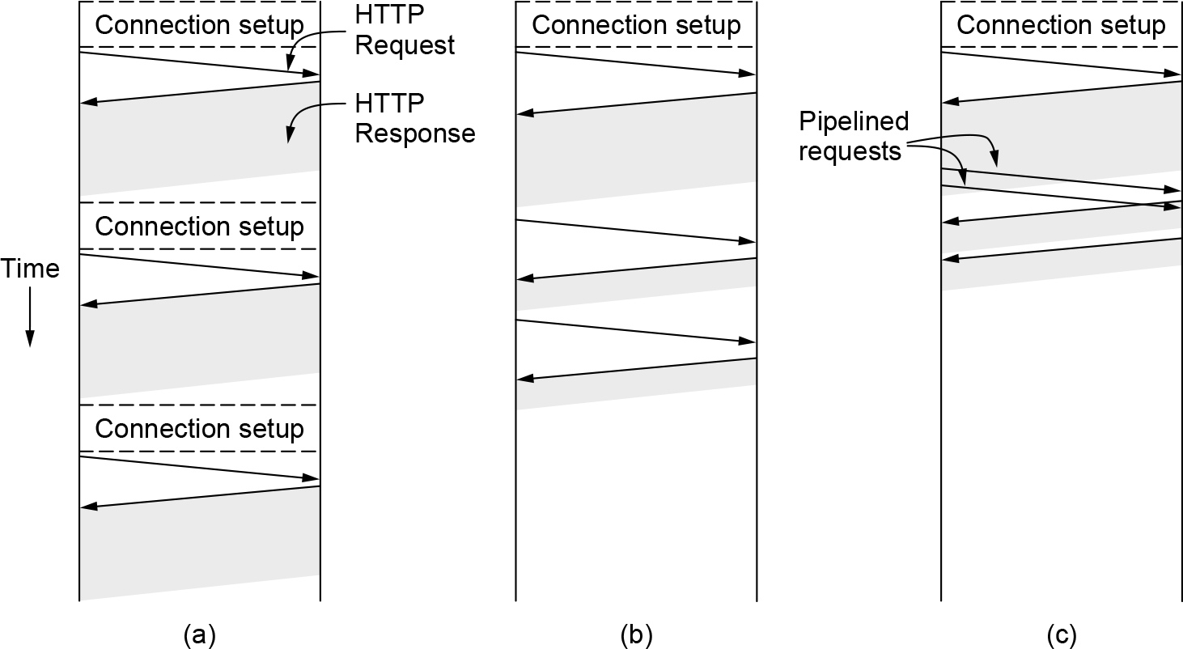
HTTP and HTTPS (6 of 7)
HTTP with (a) multiple connections and sequential requests. (b) A persistent connection and sequential requests. (c) A persistent connection and pipelined requests.

Slide 45
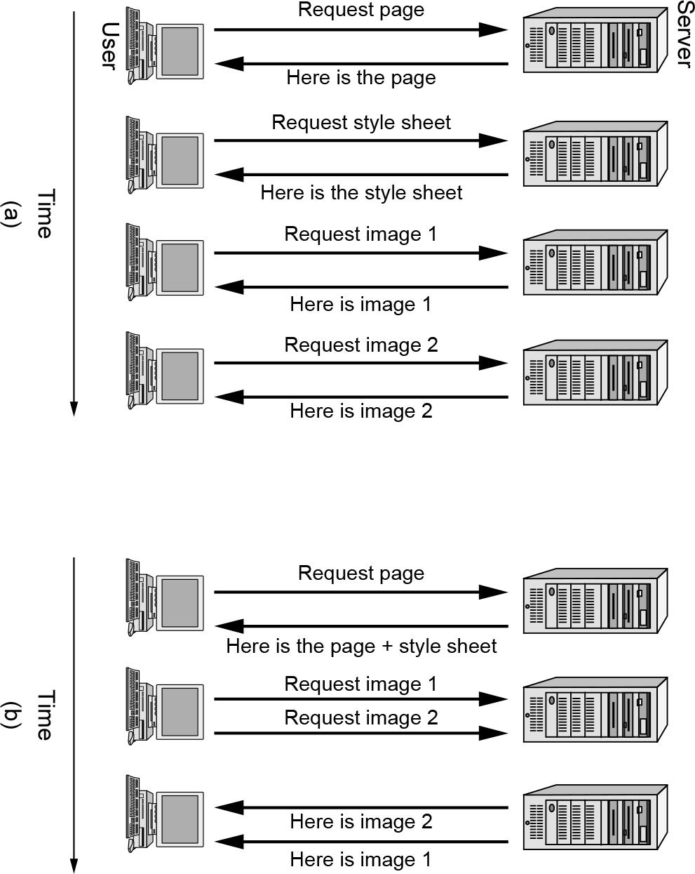
HTTP and HTTPS (7 of 7)
(a) Getting a Web page in HTTP/1.1. (b) Getting the same page in HTTP/2.

Slide 46
Web Privacy
Cookies
Third-party trackers
Device and browser fingerprinting
Cookie syncing

Slide 47
Streaming Audio and Video
Digital audio
Digital video
Streaming stored media
Real-time streaming

Slide 48
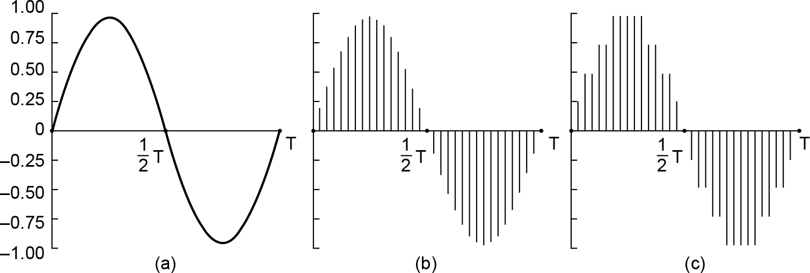
Digital Audio
(a) A sine wave. (b) Sampling the sine wave. (c) Quantizing the samples to 4 bits.

Slide 49
Digital Video (1 of 2)
MPEG frames
I (Intracoded) frames that are self-contained compressed still images
P (Predictive) frames that are difference with the previous frame
B (Bidirectional) frames that code differences with the next I-frame

Slide 50
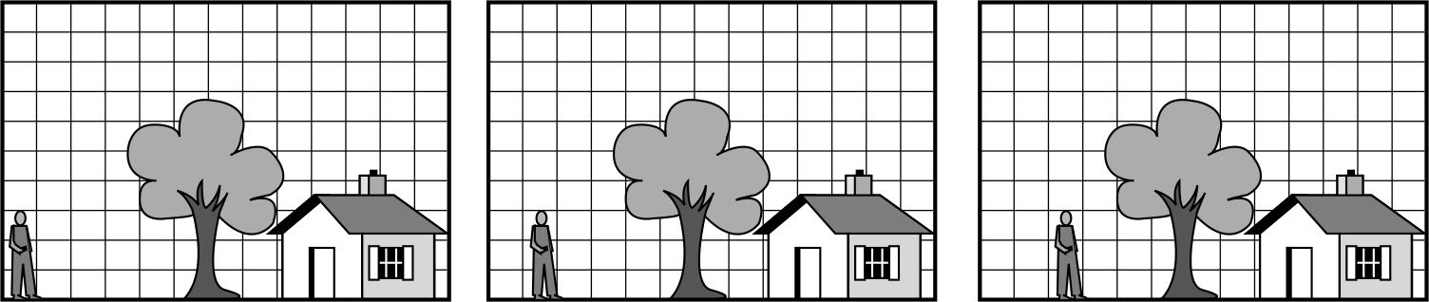
Digital Video (2 of 2)
Three consecutive frames

Slide 51
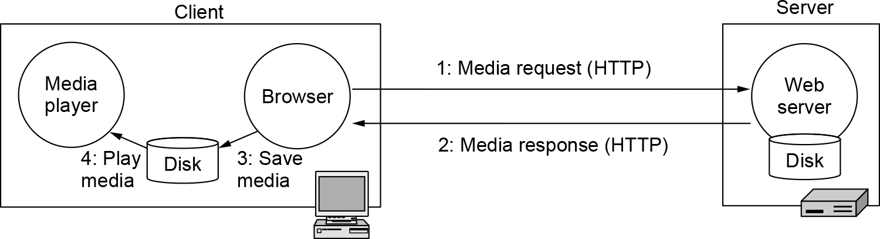
Streaming Stored Media (1 of 4)
Playing media over the Web via simple downloads

Slide 52
Streaming Stored Media (2 of 4)
A media player has five major jobs to do:
Manage the user interface
Handle transmission errors
Decompress the content
Eliminate jitter
Decrypt the file

Slide 53
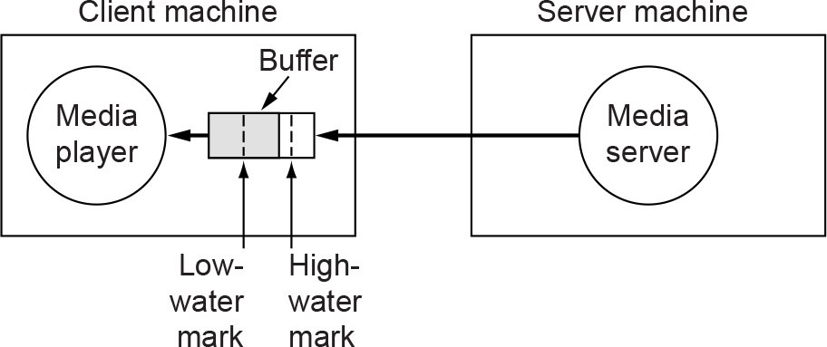
Streaming Stored Media (3 of 4)
The media player buffers input from the media server and plays from the buffer rather than directly from the network.

Slide 54
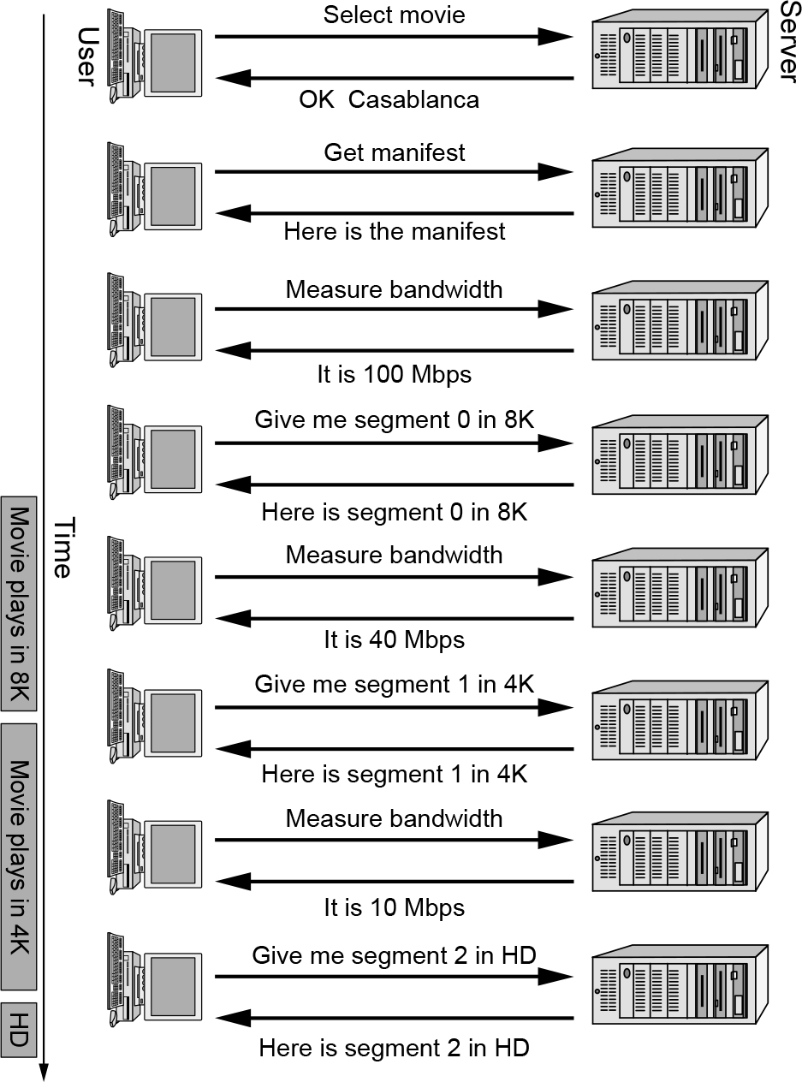
Streaming Stored Media (4 of 4)
DASH being used to change format while watching a movie

Slide 55
Real-Time Streaming (1 of 7)
Voice over IP
H.323
SIP—the Session Initiation Protocol
Comparison of H.323 and SIP

Slide 56
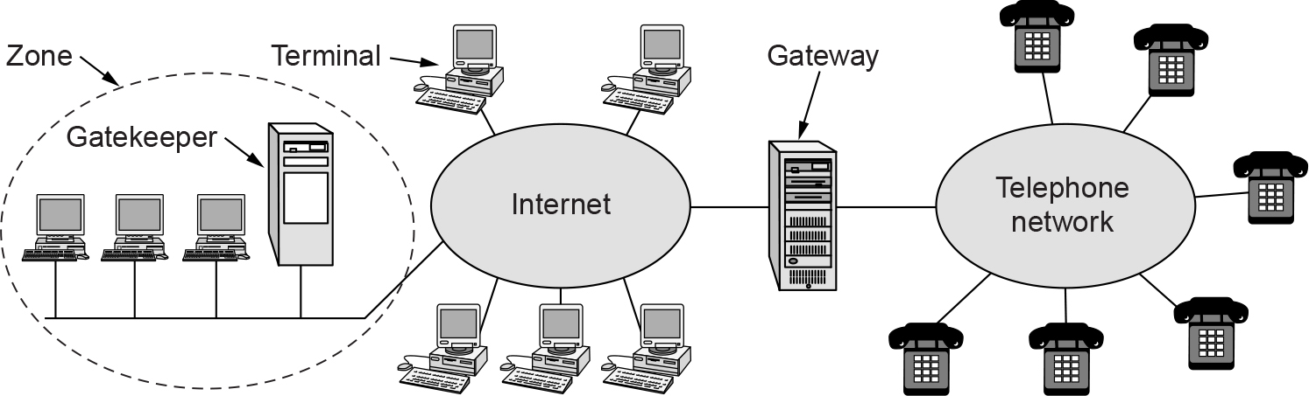
Real-Time Streaming (2 of 7)
The H.323 architectural model for Internet telephony

Slide 57
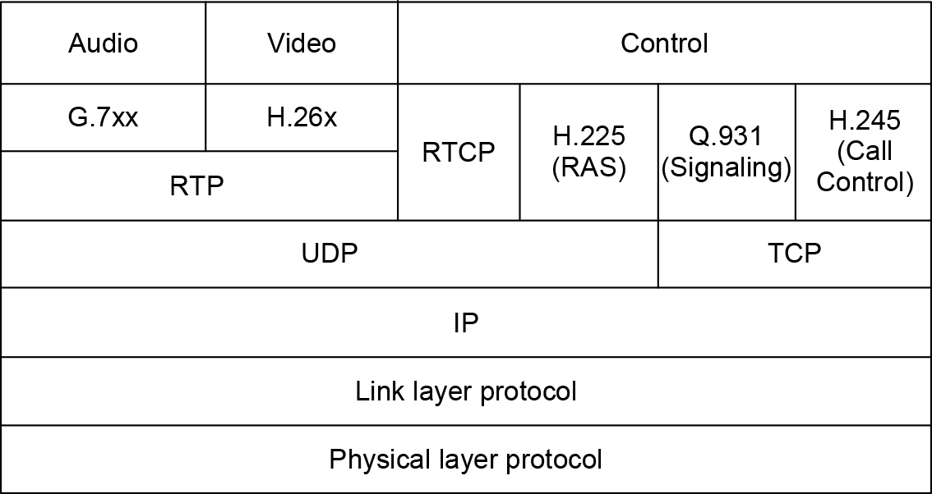
Real-Time Streaming (3 of 7)
The H.323 protocol stack

Slide 58
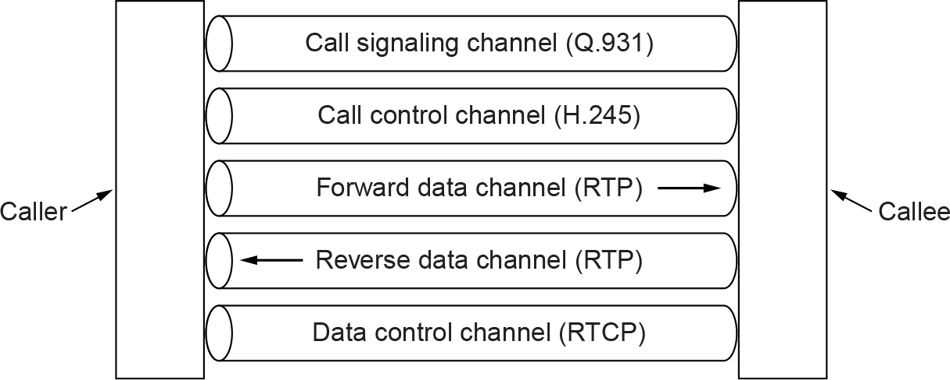
Real-Time Streaming (4 of 7)
Logical channels between the caller and callee during a call

Slide 59
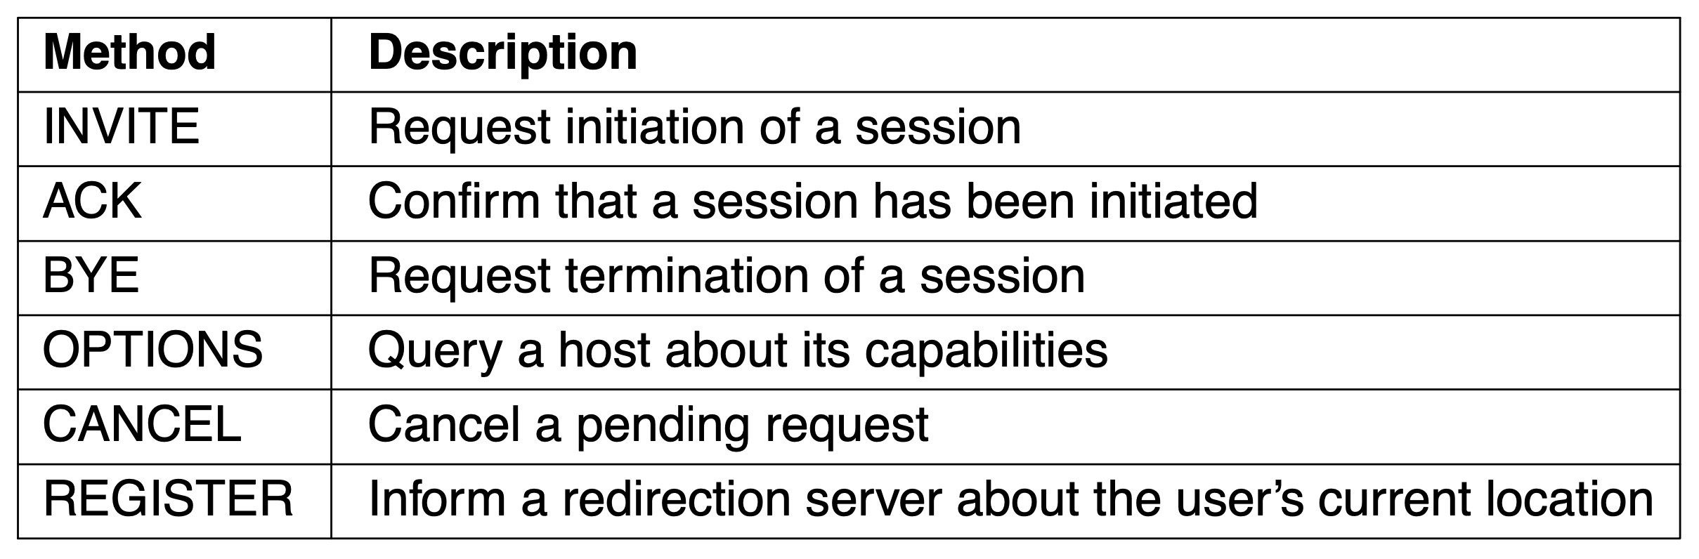
Real-Time Streaming (5 of 7)
SIP methods

Slide 60
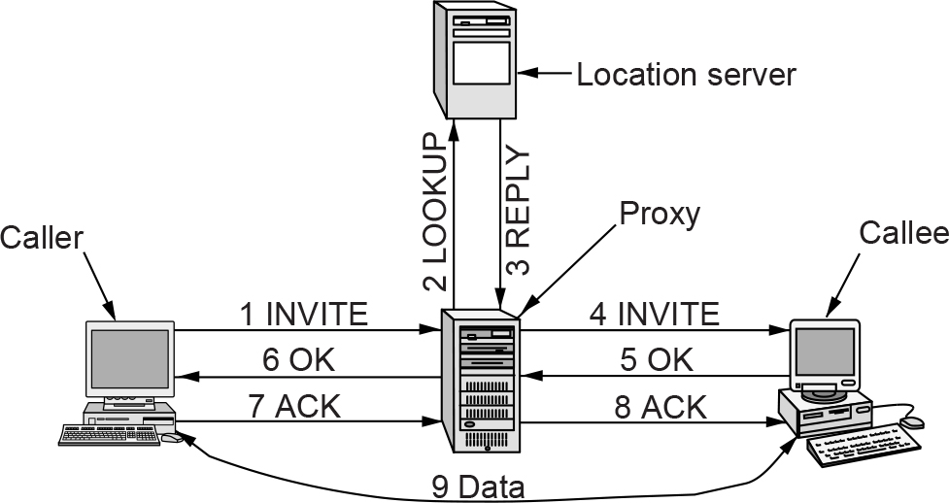
Real-Time Streaming (6 of 7)
Use of a proxy server and redirection with SIP

Slide 61
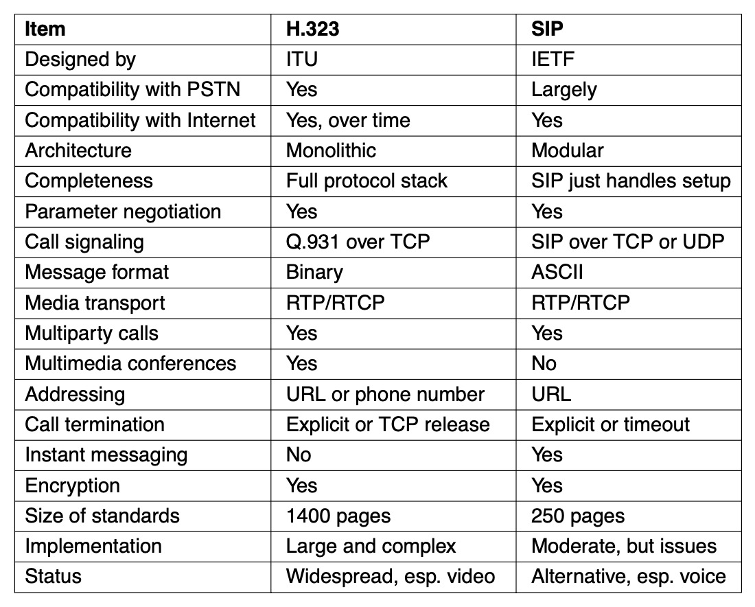
Real-Time Streaming (7 of 7)
Comparison of H.323 and SIP

Slide 62
Content Delivery
Content and Internet traffic
Server farms and Web proxies
Content delivery networks
Peer-to-peer networks
Evolution of the Internet

Slide 63
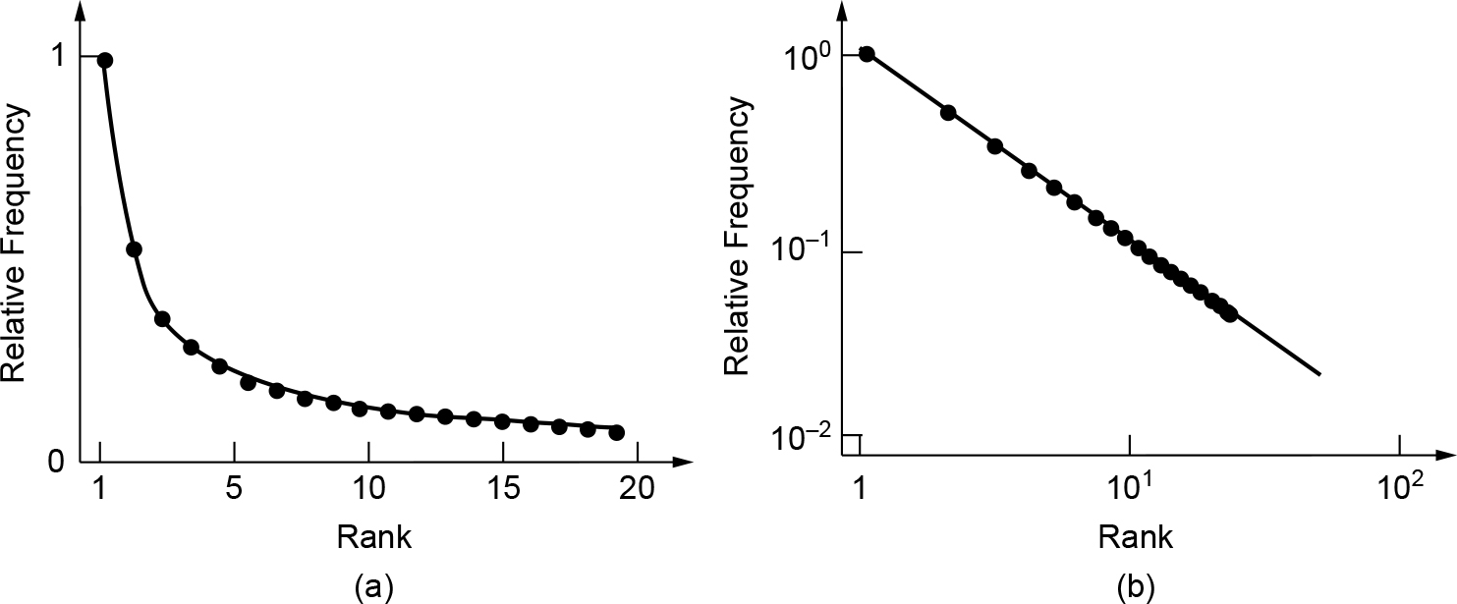
Content and Internet Traffic
Zipf distribution (a) On a linear scale. (b) On a log-log scale

Slide 64
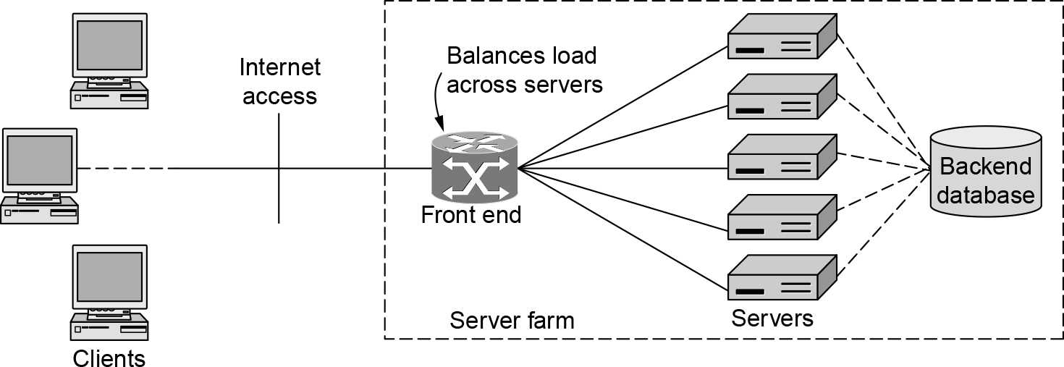
Server Farms and Web Proxies (1 of 2)
A server farm

Slide 65
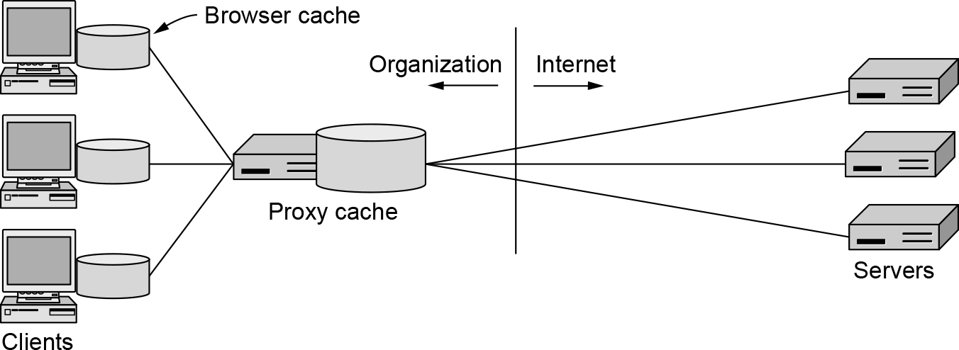
Server Farms and Web Proxies (2 of 2)
A proxy cache between Web browsers and Web servers

Slide 66
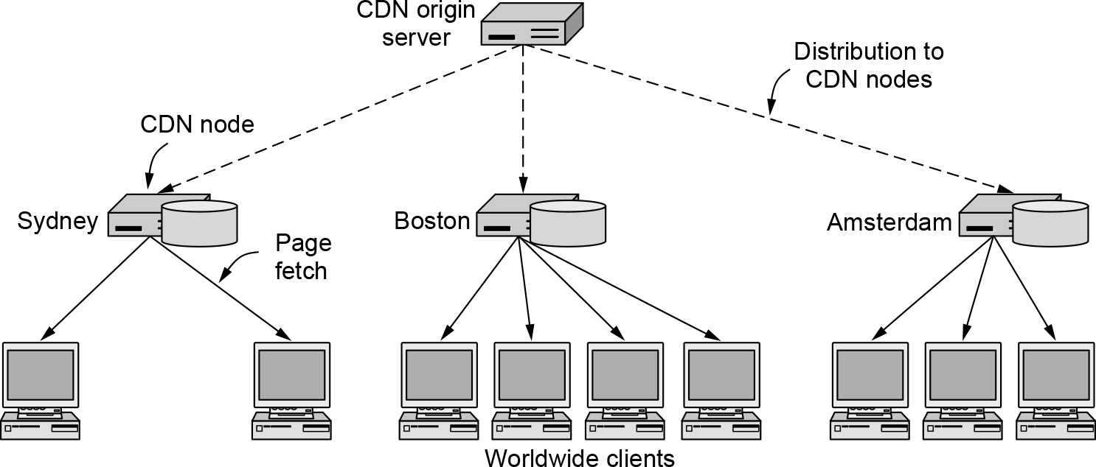
Content Delivery Networks (1 of 2)
CDN distribution tree

Slide 67
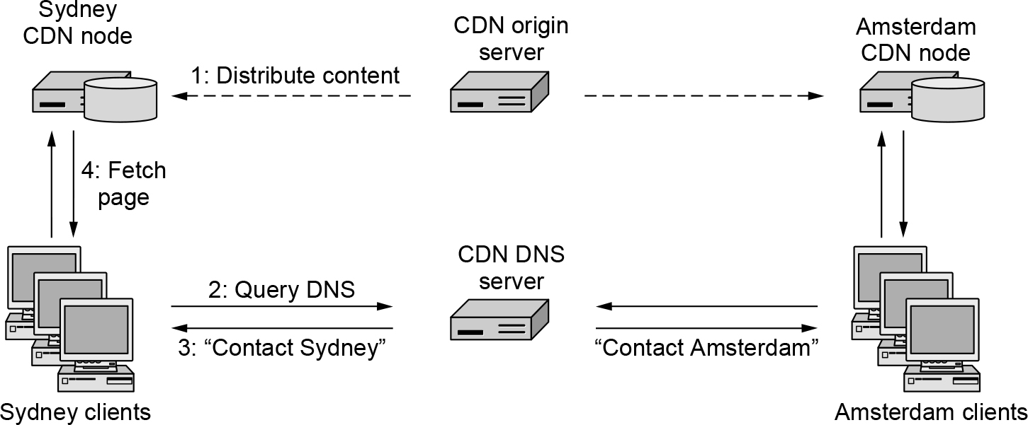
Content Delivery Networks (2 of 2)
Directing clients to nearby CDN nodes using DNS.

Slide 68
Peer-to-Peer Networks (1 of 3)
Overview
Early peer-to-peer networks: Napster
Decentralizing the directory: Gnutella
Coping with scaling, incentives, and verification: BitTorrent

Slide 69
Peer-to-Peer Networks (2 of 3)
Problems to be solved with BitTorrent sharing
How does a peer find other peers?
How is content replicated by peers to provide high-speed downloads?
How do peers encourage each other to upload content to others?

Slide 70
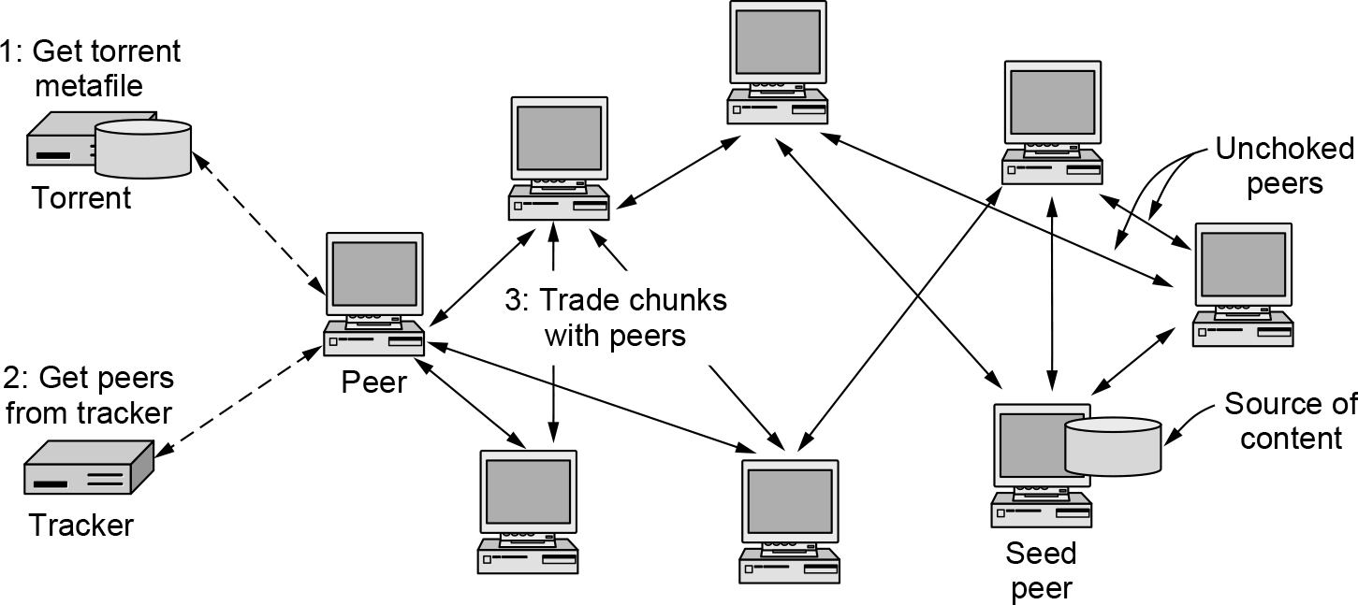
Peer-to-Peer Networks (3 of 3)
BitTorrent

Slide 71
Evolution of the Internet (1 of 3)
ARPANET and the early Internet components
Hosts (the computers that did the work for the users)
Routers (called IMPs in the ARPANET) that switched the packets
Transmission lines (originally 56-kbps leased telephone lines)

Slide 72
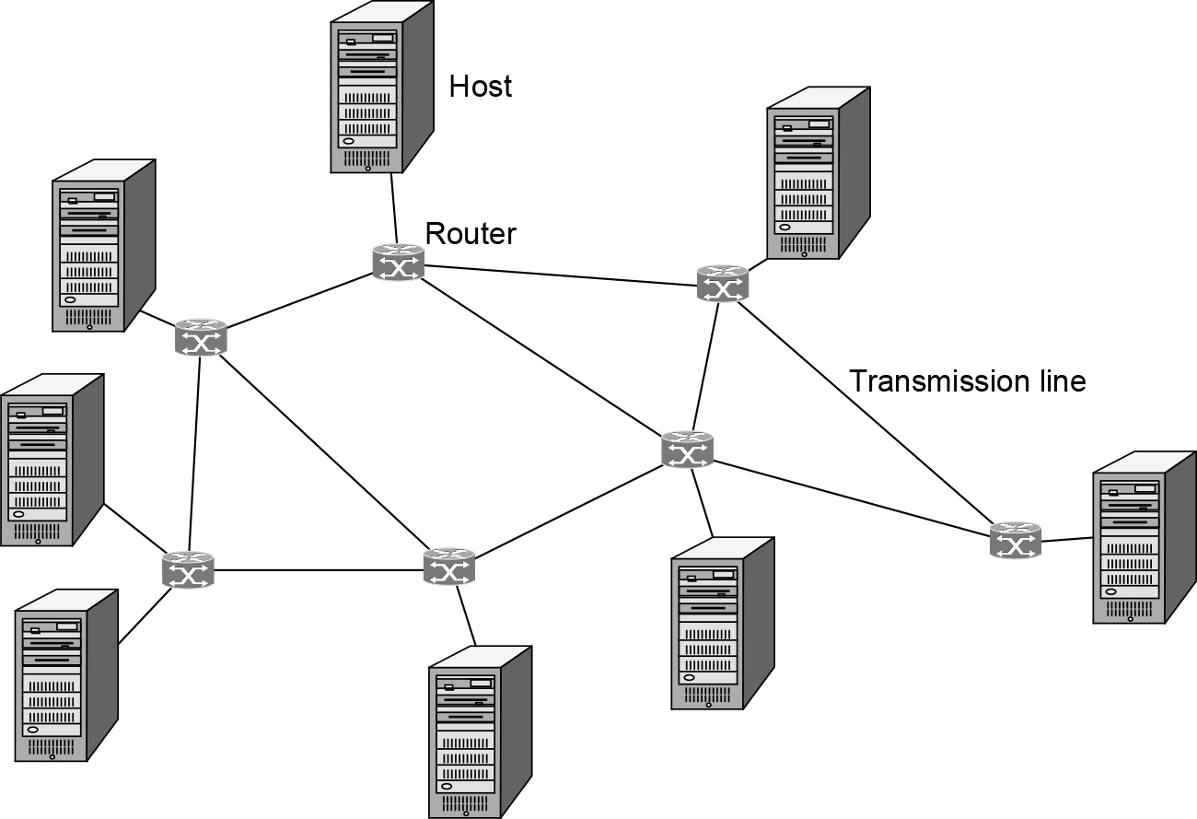
Evolution of the Internet (2 of 3)
The early Internet involved primarily point-to-point communications

Slide 73
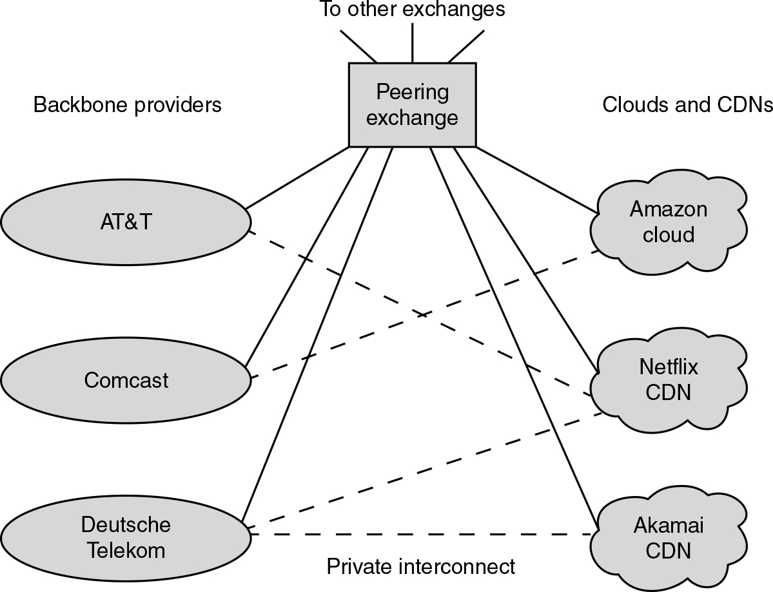
Evolution of the Internet (3 of 3)
Most Internet traffic today is from clouds and CDNs, with a significant amount of traffic being exchanged between access networks and ISPs over private interconnects.

Slide 74

Copyright
This work is protected by United States copyright laws and is provided solely for the use of instructors in teaching their courses and assessing student learning. Dissemination or sale of any part of this work (including on the World Wide Web) will destroy the integrity of the work and is not permitted. The work and materials from it should never be made available to students except by instructors using the accompanying text in their classes. All recipients of this work are expected to abide by these restrictions and to honor the intended pedagogical purposes and the needs of other instructors who rely on these materials.

